Slide 1
David Muench
Ashlyn Hoffmann

Slide 2
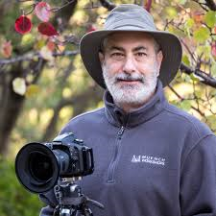
Place and Date of Birth
David Muench was born in Santa Barbra California, June 25th 1936
He is now 79 years old, he has a company called Muench Workshops with his two kids who have become successful photographers.

Slide 3
Methods and Subject Matter
“As a two-time Canon Explorer of Light, I worked with the Canon Systems cameras that were the mainstay of my 35mm work. Participation in a UNESCO/Panasonic sponsored project to photograph World Heritage Sites propelled me into learning to photograph with digital cameras. I revel in the freedom these cameras bring. But, for me, photography—with any kind of camera-- is a matter of seeing.”
Prominent foreground elements leading the eye through the frame to the background in the distance was a style that Muench became known for back in the 50’s and 60’s.
David Muench is a Landscape Photographer

Slide 4
Path to Success
Muench got the idea of becoming a photographer from his father who was a photographer and from then on he worked hard at becoming a photographer just like his father.
“Our childhoods set our paths. Finding in them the directions we wish to go, the paths lead us deeper and deeper into our lives. I was lucky. I watched my father do the work that led me into my own work. I helped him in that work . . . as a young child as his model, as a teenager, printing his black and white photographs. I made my first photographs as a teenager in the late 1950s, and had my first photographs published as front and back covers of Arizona Highways when Raymond Carlson was editor, and I was still in high school. There was never any question of my career. My education in photography and in art – both at Rochester Institute of Technology in Rochester, NY, and the Los Angeles Art Center School of Design -- provided me with the formality of a degree in photography, and an understanding of the technology of the time, but I felt – and continue to feel – that my most profound learning experiences were in the field. Even now, as the technology of photography explodes in directions undreamed of in my early days, and as I continue to learn, to expand in new directions, it is nature that remains my teacher”

Slide 5
Techniques
amazing lighting.
adds great value to his images.
great depth of field in his images.
low horizon line on most of his images.
only does special single photos.

Slide 6
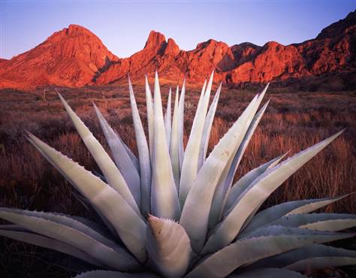
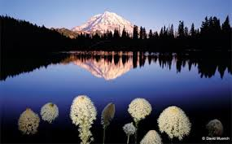
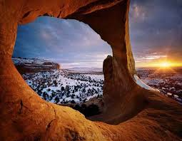
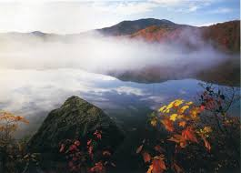
Most Popular Images

Slide 7
Impact
David Muench is a teacher who influences young nature photographers, he has impacted many people with his photos including his own kids, who have decided to follow their fathers path in becoming photographers as well. He has inspired many young photographers to follow their dreams.

Slide 8
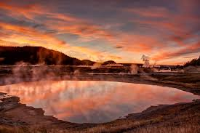
Firehole river sunset

Slide 9
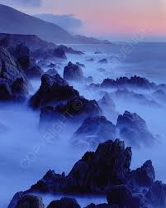
Garrapata-Dawn

Slide 10
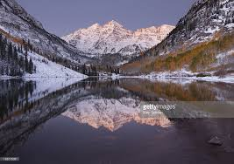
Dawn Reflections Maroon Bells

Slide 11
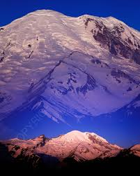
White River View

Slide 12
Personal Reflection
I picked David Muench because he is a landscape photographer who likes to capture lots of color. I like this because those are the kind of photos I like to take, I like a picture with not much going on but lots of color and natural beauty. He also likes to guide the viewers eye to the color which is usually a sunset or mountain. I mostly picked David Muench because I feel like I connect to him the most out of all of the photographers. I also love capturing landscapes especially with sunsets. His images tell a story and make you want to pack your bags and go on an adventure it is amazing to see what else is in the world besides what we have come to know and David Muench captures that beautifully. Also he lives in Santa Barbra California which is where I want to move when I am older.

Slide 13
Blackstone
Muech’s Version
My Version

Slide 14
Eagle Creek Gorge
Muench’s Version
My Version

Slide 15
Montana Wild
Muench’s Version
My Version

Slide 16
Title Unknown
Muench’s Version
My Version

Slide 17
SELFIES!

Slide 18
Website Sources
http://www.davidmuenchphotography.com/david_muench.htm#.Vm3mQdIrKt8
http://www.davidmuenchphotography.com/portfolios/cccp200-1a.htm#.Vm3n49IrKt8
http://www.muenchphotography.com/
https://prezi.com/rrlo-zz7qztc/david-muench-photo_5/

