Slide 2
Photo Editing Apps
Ashlyn Hoffmann

Slide 3
Repix
-Repix is a free photo editing app
-You have to have an Android device to run Repix.
-15 million downloads
~The full version costs $1.99
~There are in app purchases to get special brushes, frames, and filters ($.99 each)

Slide 4
Repix:
Informational Websites
www.amazon.com/Sumoing-Repix-Full-Version/dp/B00G5AVM3S
www.androidtapp.com/repix
www.148apps.com/reviews/repix-review
sumoing.com/apps/repix

Slide 5
Repix:
Tutorials
www.youtube.com/watch?v=xjZzbDl_p-I
www.youtube.com/watch?v=wqJpH5ZJXyk
http://www.bing.com/videos/search?q=youtube+repix+tutorials&qpvt=youtube.com%2fRepix+tutorials&FORM=VDRE#view=detail&mid=114A2589B3AEA1EE6172114A2589B3AEA1EE6172

Slide 6
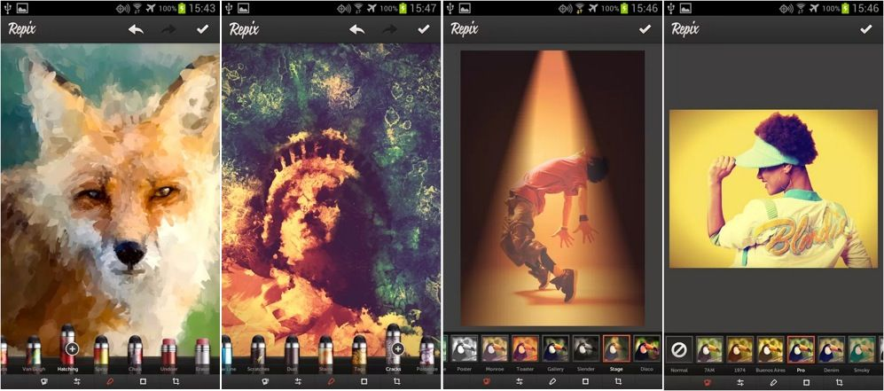
Repix:
Examples of Others Digital Art

Slide 7
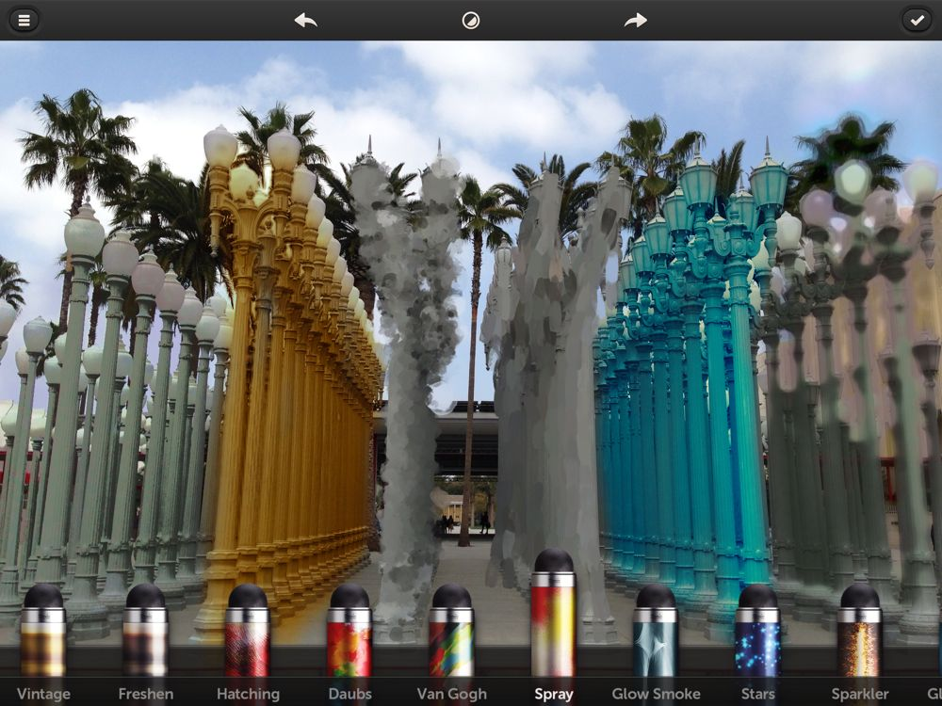
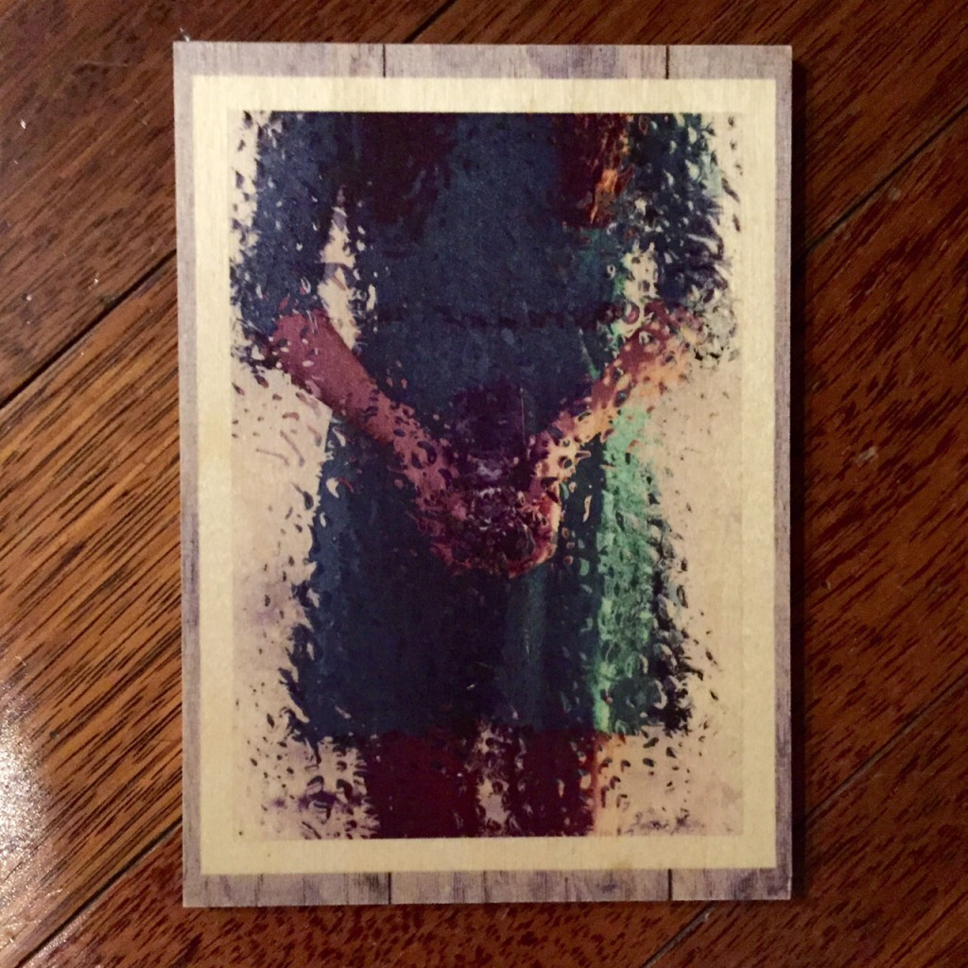
This person printed off a piece of their work and stuck it to a slab of wood
This image shows of some of the different effects to these lamp posts.

Slide 8
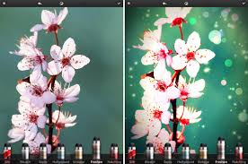
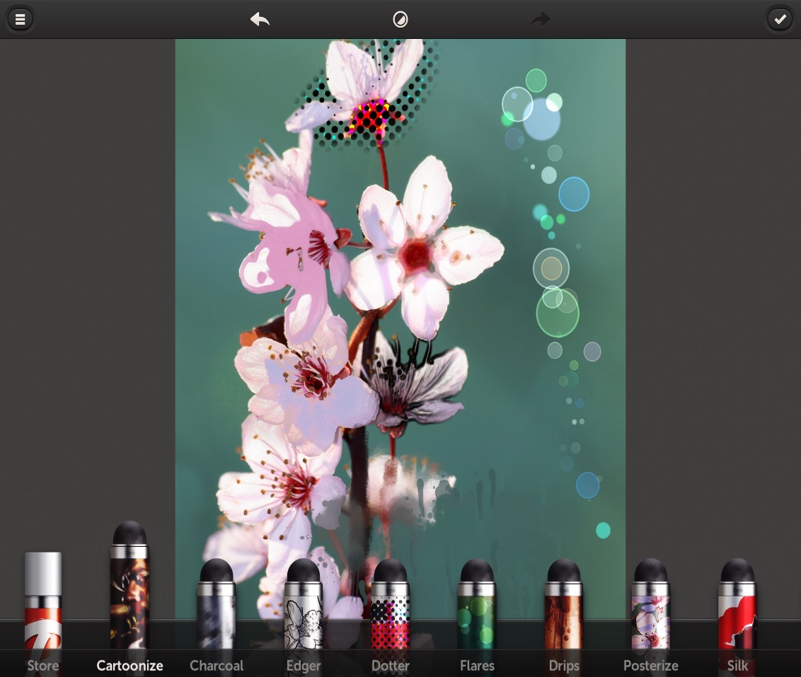
Starting image
Edited image
Different edited image

Slide 9
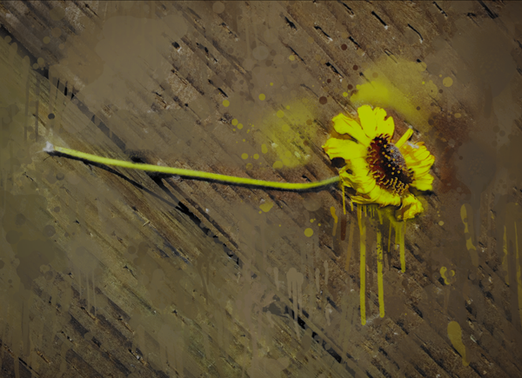
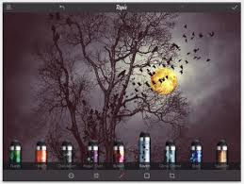

Slide 10
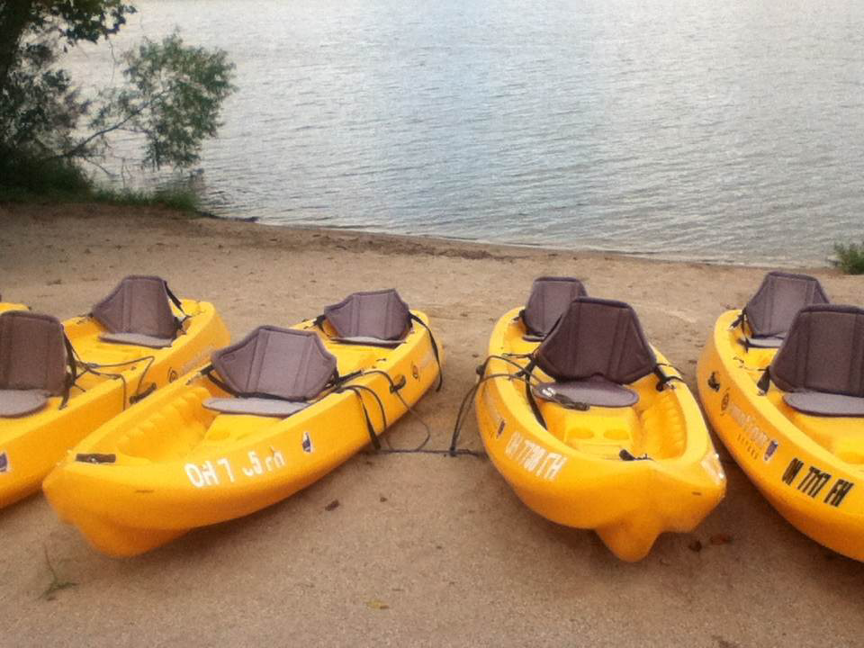
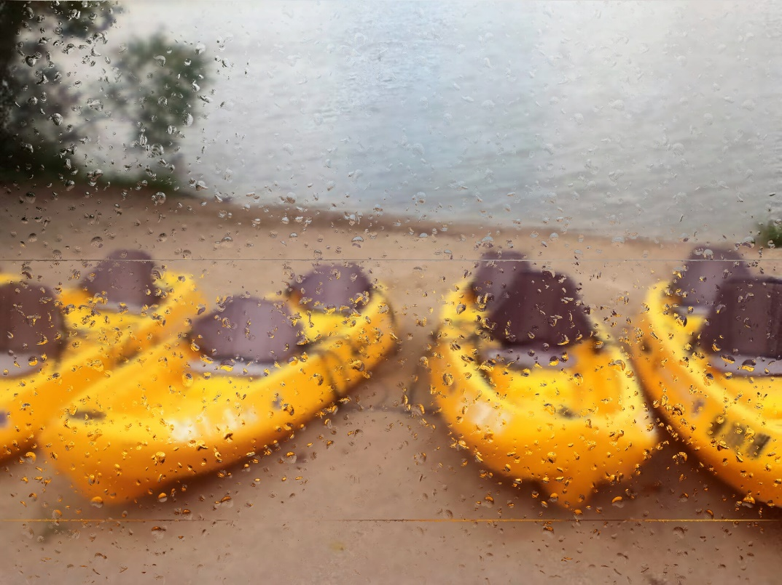
Repix:
Examples of My Digital Art
Original
After Repix

Slide 11
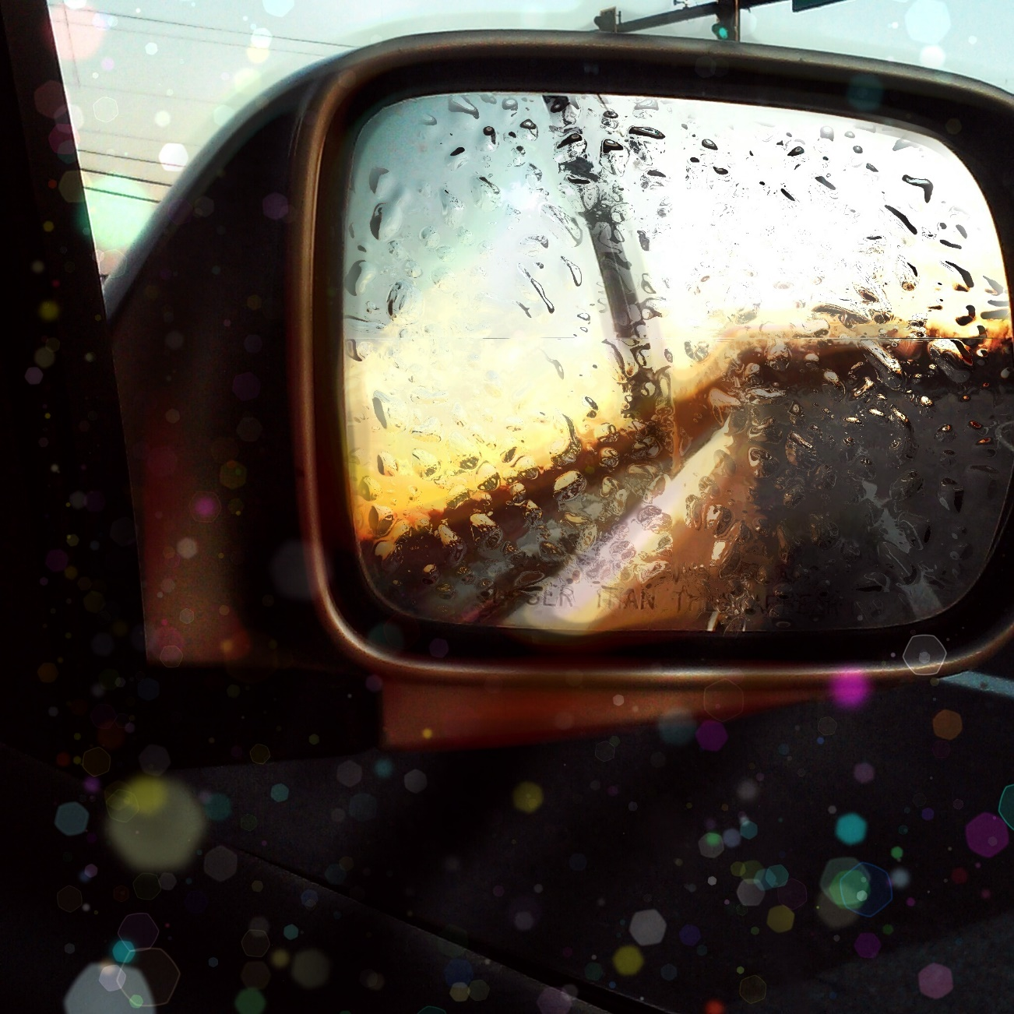
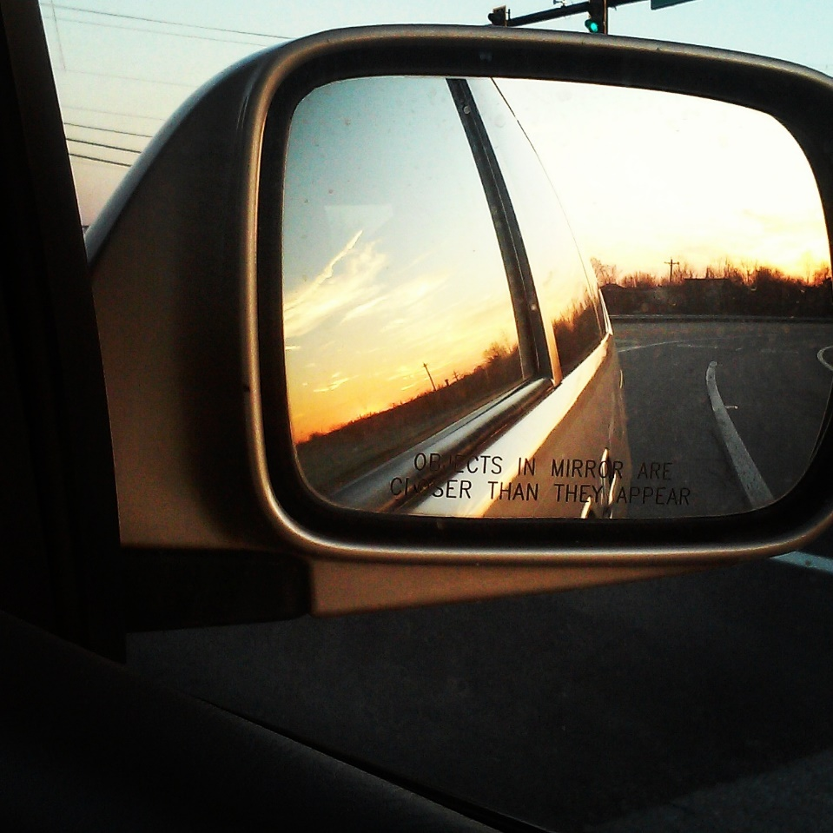
Original
After Repix

Slide 12
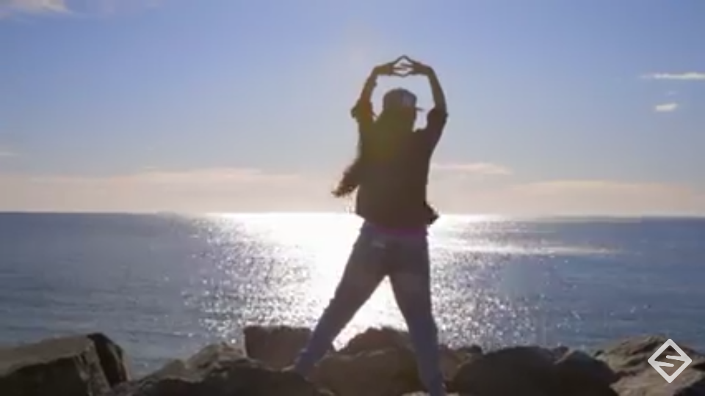
Original
After Repix

Slide 13
THE END

